Slide 1
Apache Spark
Using Broadcast Variables and Accumulators

Slide 2
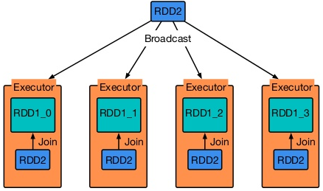
Broadcast Variables
Is read-only

Slide 3
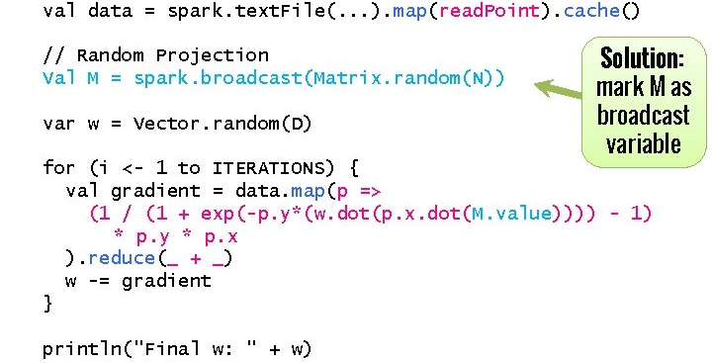
Broadcast Variables

Slide 4
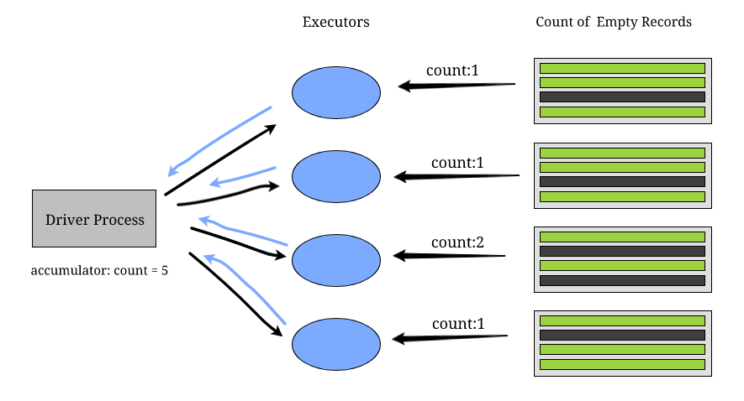
Accumulator

Slide 5
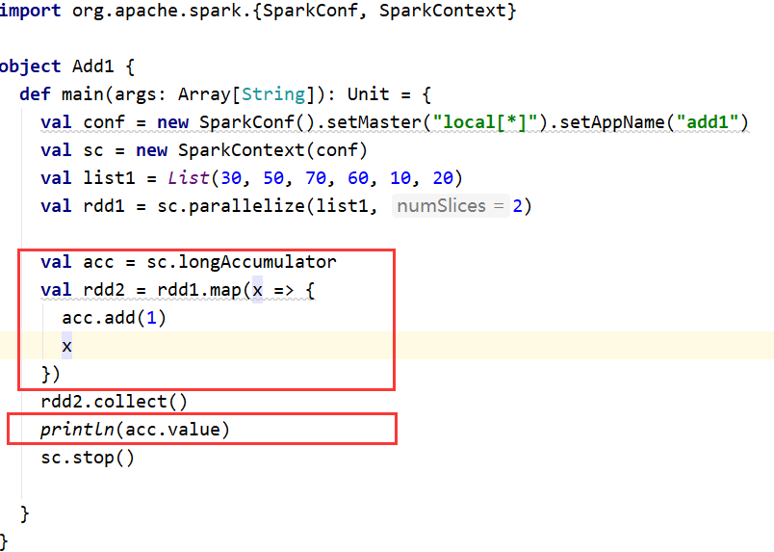
Accumulator

Slide 6
Thanks

